Slide 1
Technical Lesson 01
SECU8010
Fundamentals of InfoSec
System Setup
Baljeet S. Bilkhu, BASc., MScIS
bbilkhu@conestogac.on.ca

Slide 2
Introduction
The nature of the technical lectures is to expose you to the various practical aspects of InfoSec.
There are no lab exercises that you will submit during this course. However, the material in these lectures may be on the assessments.
Also, these lectures will assist in completing the assignments.

Slide 3
Overview
Installing VMWare Workstation Player / Virtual box
Installing 7-zip
Installing Kali Linux
Installing Metasploitable 2

Slide 4
Background
We are going to be setting up an isolated test network consisting of an attacking machine (Kali) and our victim…I mean target ☺ (Metasploitable 2).
Please follow the slides on the next pages to setup both (before next class).

Slide 5
Downloading VMWare / Virtual Box
Download VMWare from here:
Download VMware Workstation Player | VMware | CA
Or, if you prefer, use Virtual Box:
Downloads – Oracle VM VirtualBox
Go through the installation process for either

Slide 6
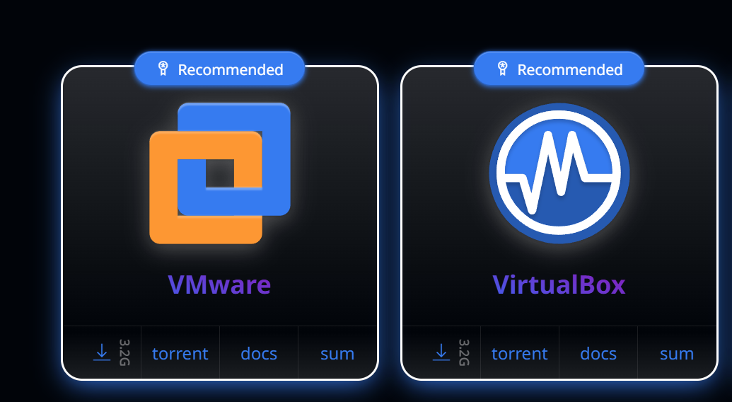
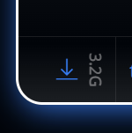
Download Kali
Go to: Get Kali | Kali Linux to download your version of Kali – depending upon if you are using VMWare or Virtual Box (this will take a while ☺).
From either, click on the download link:

Slide 7
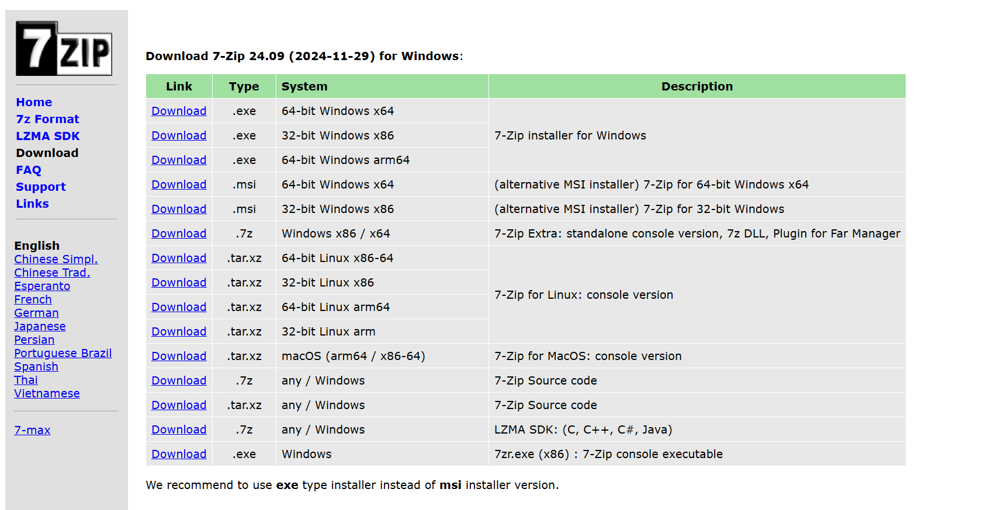
Downloading and Installing 7-zip
The image file for Kali that gets downloaded is of type .7z – as such, you’ll need to download and install the unzipper program as well: Download (7-zip.org)

Slide 8
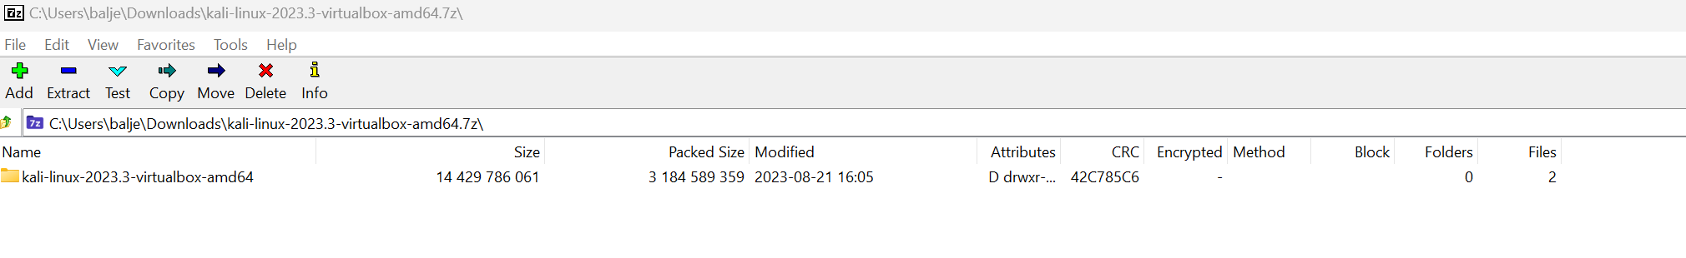
Unzipping Kali
After the Kali image has finished downloading, double-click on it from your File Manager and then Extract it (anywhere on your Hard Drive):
This may take several minutes…

Slide 9
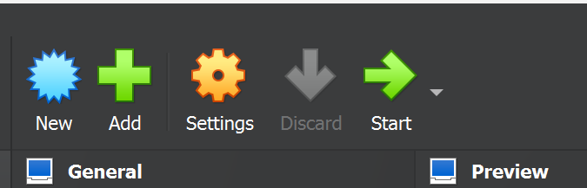
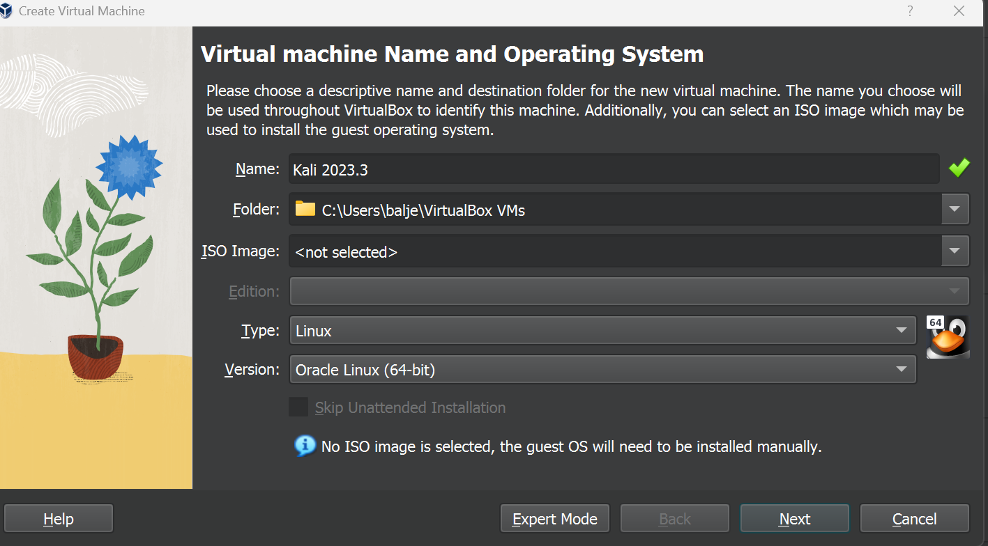
Installing Kali (Virtual Box)
Open up Virtual Box and click on New
Provide a Name and select Linux as the Type.
Click Next

Slide 10
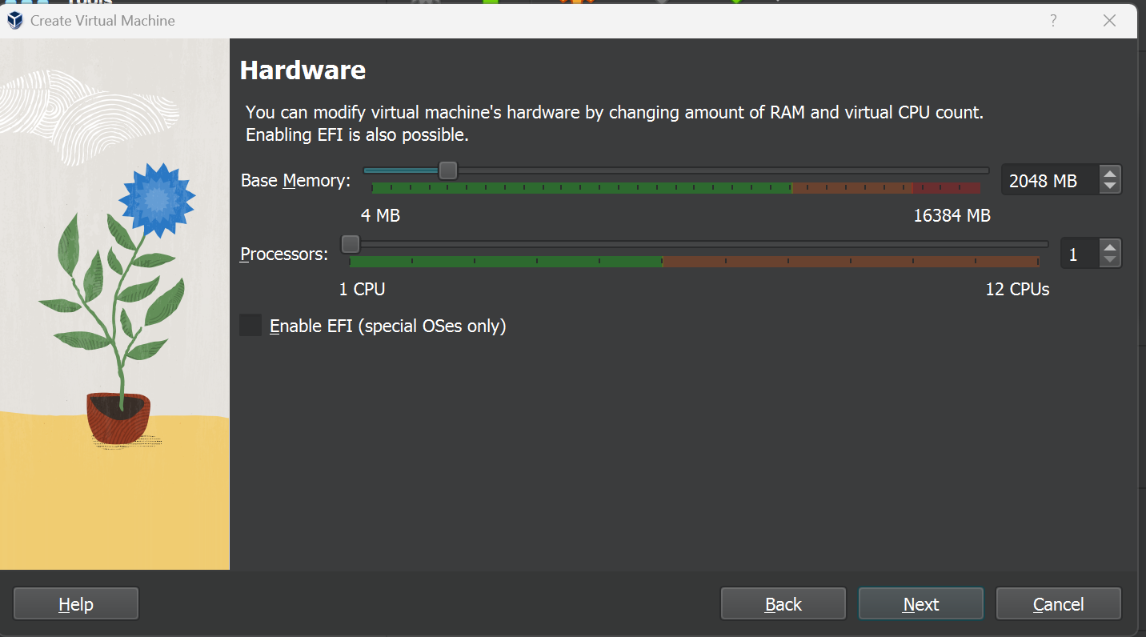

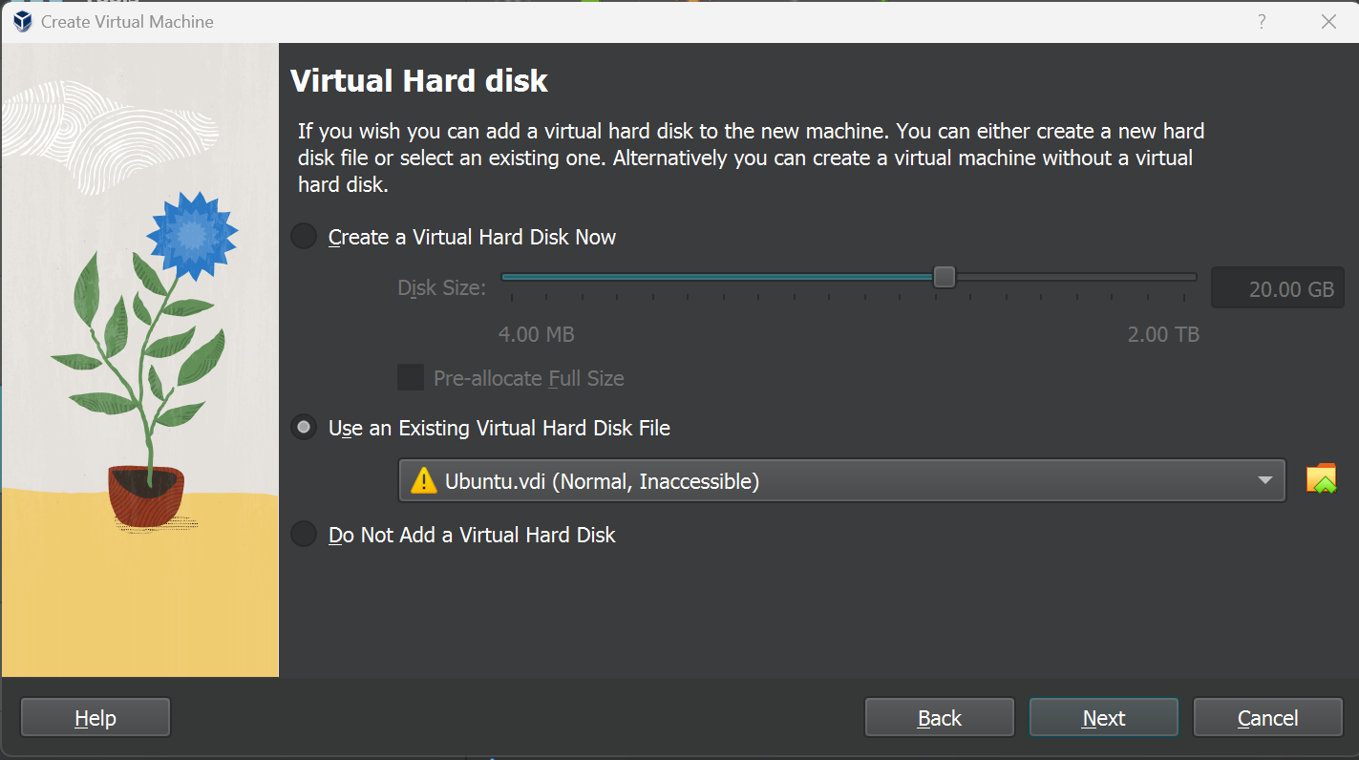
Installing Kali (Virtual Box)
Ensure that you have at least 2048MB of memory and 1 CPU. Click Next
Select “Use an Existing Virtual Hard Disk File” and click on the icon.
Click on Add on the next screen.

Slide 11
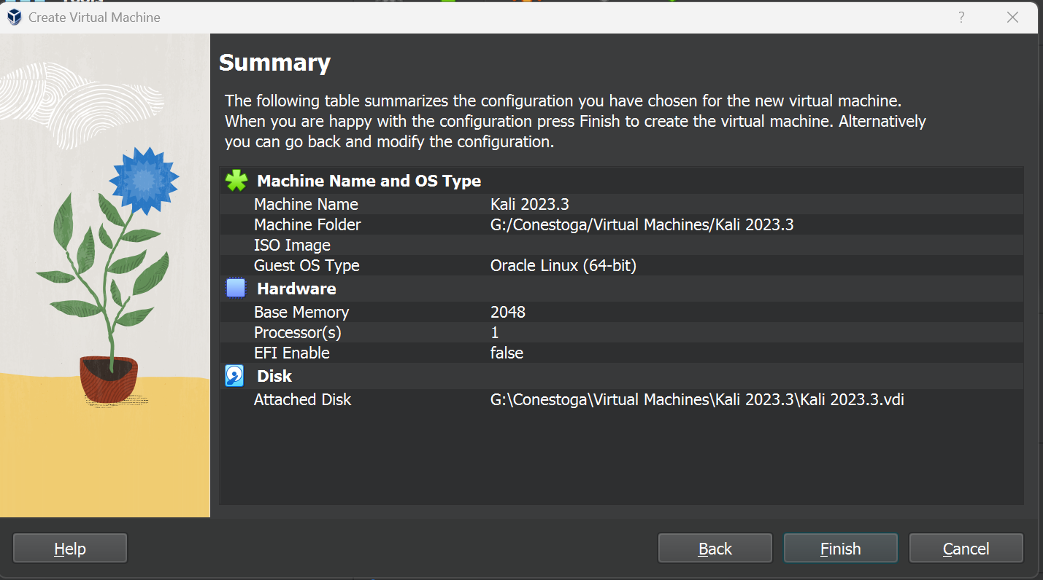
Installing Kali (Virtual Box)
Navigate to and select your Kali (unzipped) file from a previous step
Click on Choose to continue.
Then click on Next and then Finish

Slide 12
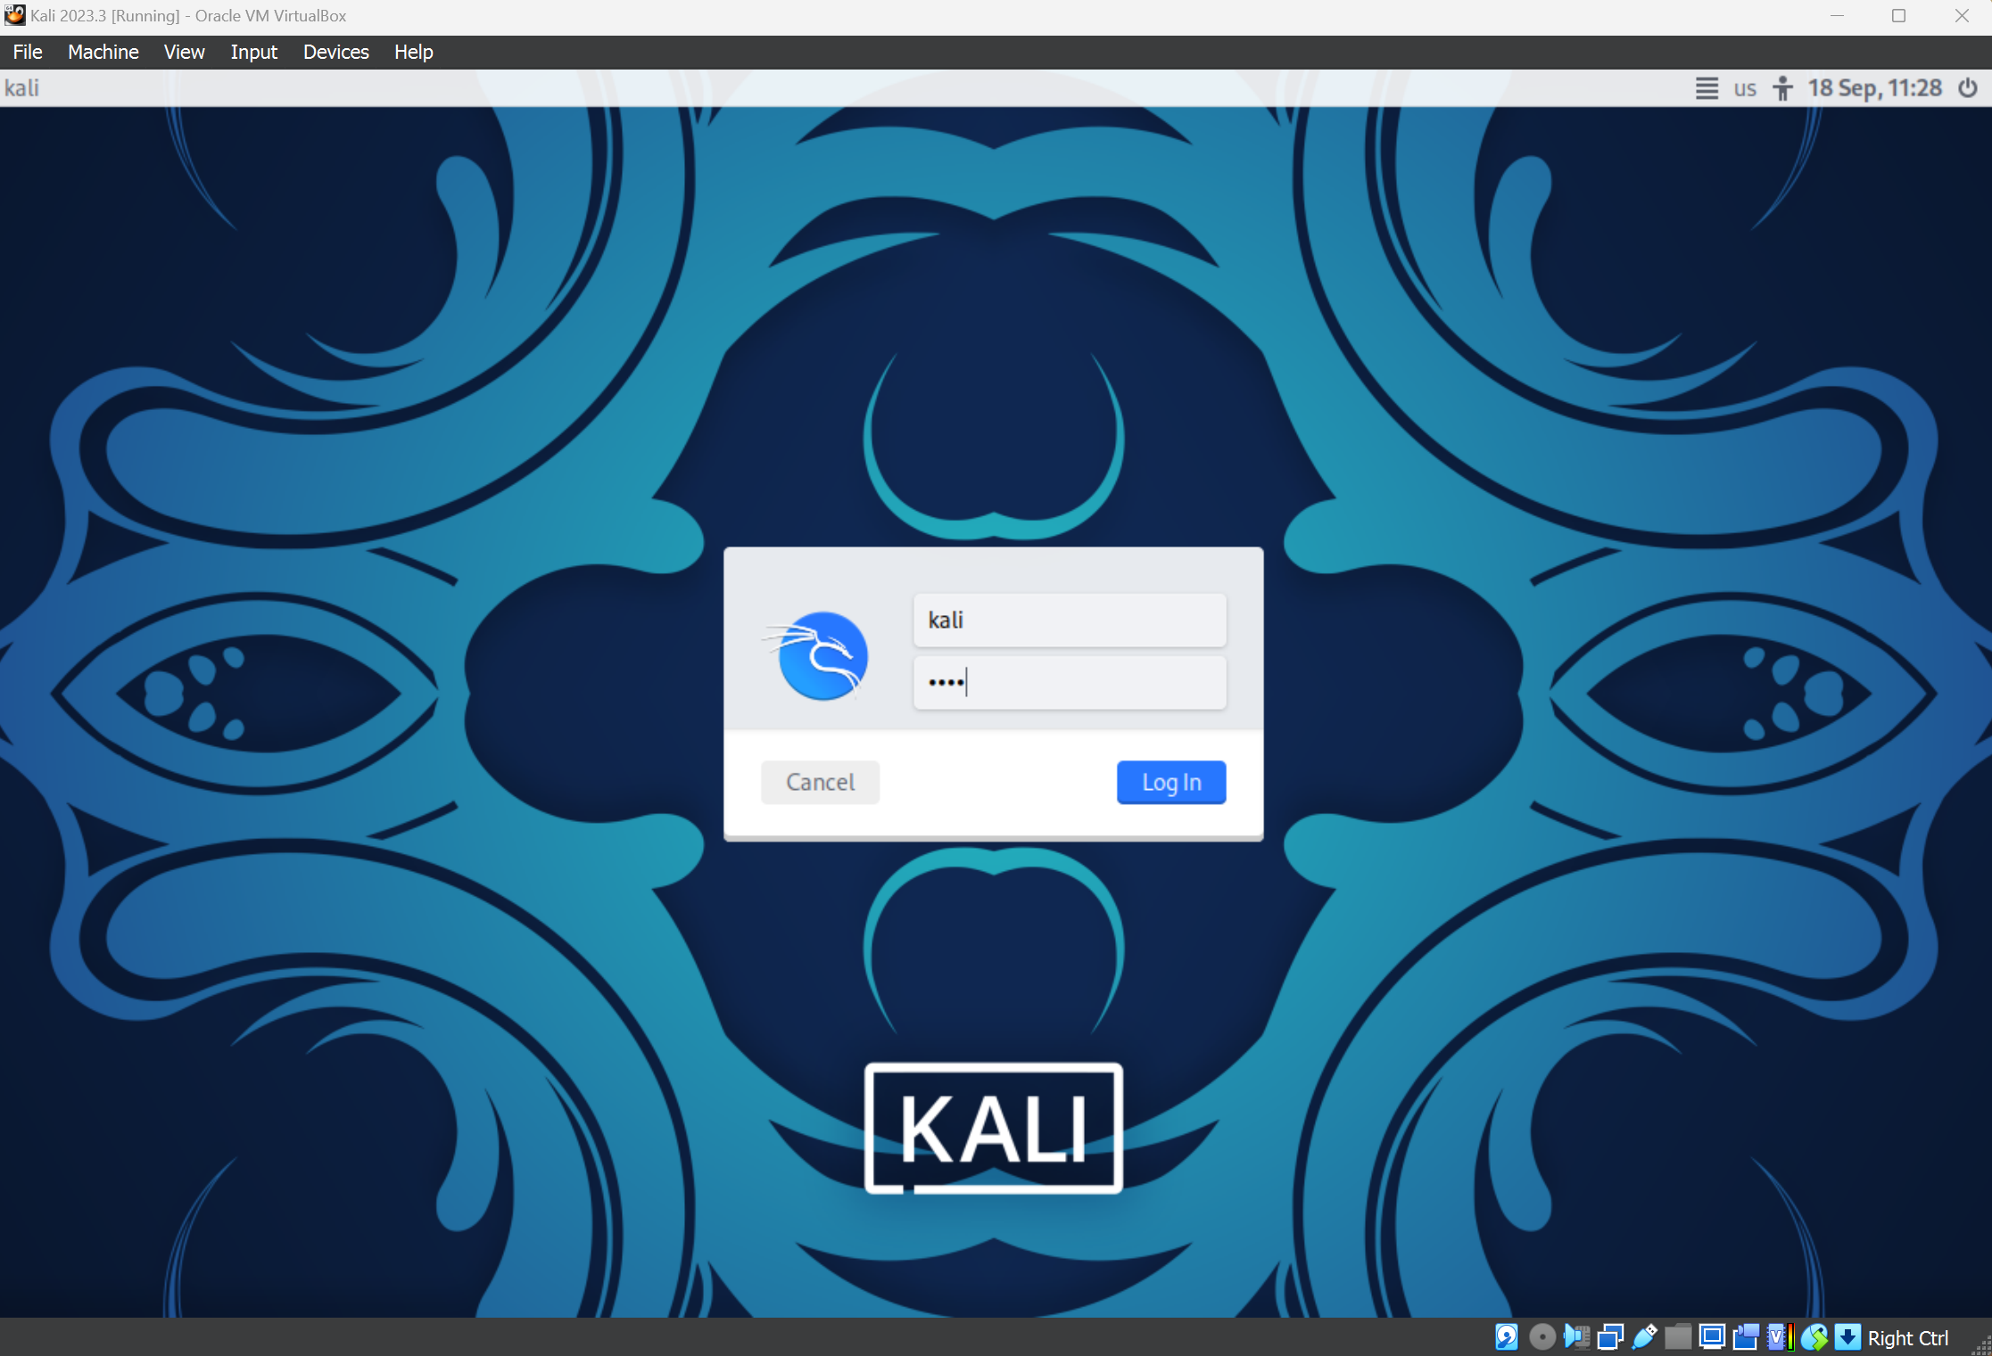
Running Kali (Virtual Box)
Double click on the VM that was just created.
This may take a few minutes
Login using kali / kali as the username / password.

Slide 13
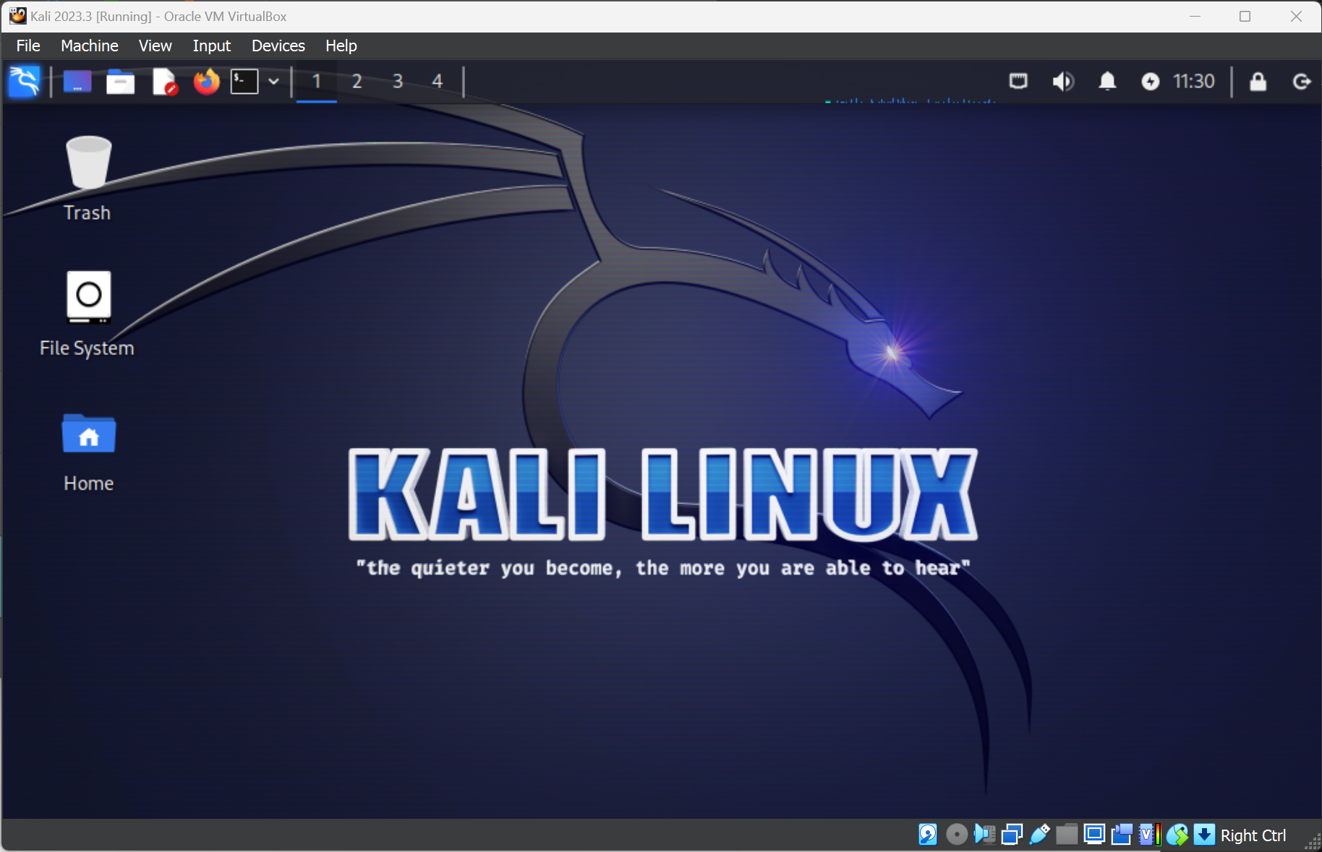
Kali Running

Slide 14
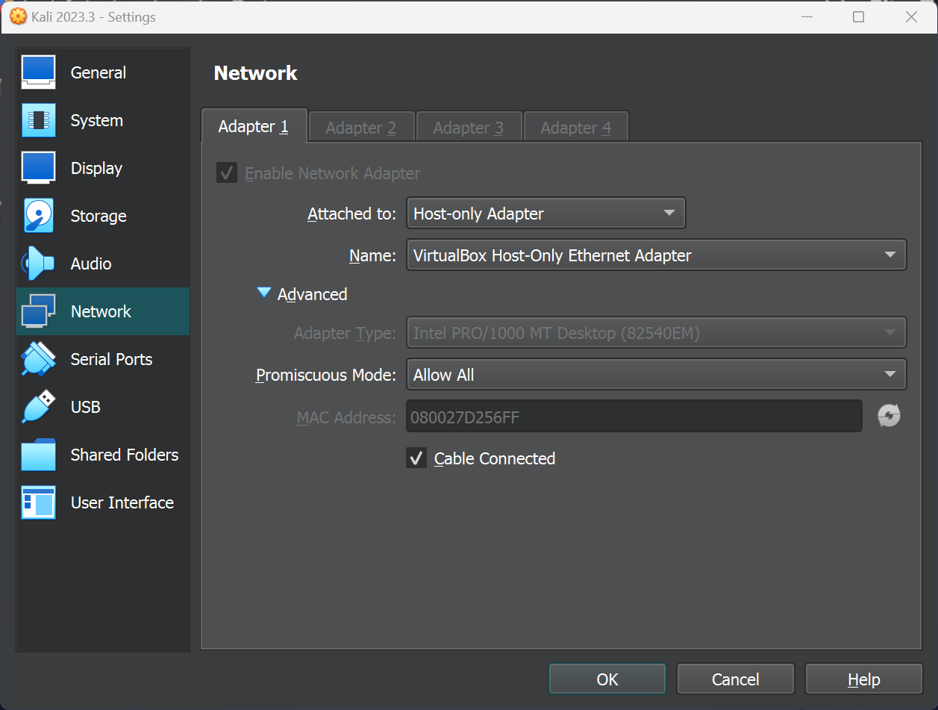
Configuring Network
Go into Machine | Settings | Network
Ensure that the following are set:
Click on OK
Restart your VM

Slide 15
Installing Metasploitable 2
Go to: Download Metasploitable - Intentionally Vulnerable Machine | Rapid7
Sign Up with your details
Your download may not proceed – simply bypass (keep)
Follow the remaining steps from: https://youtu.be/g1JnLIfTjzM?si=Uu2-q5LtEV5BLj7M

Slide 16
Configuring Network
Go into Machine | Settings | Network
Ensure that the following are set:
Click on OK
Restart your VM

Slide 17




Any questions?

